Slide 1
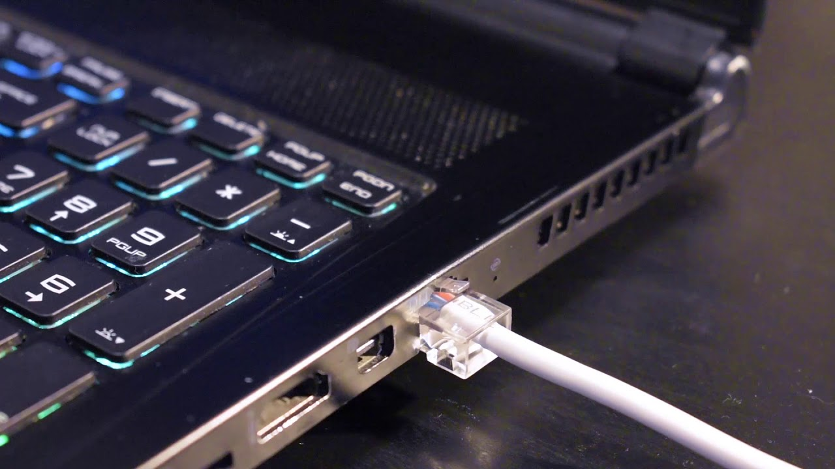
SC1006
Computer Organization and Architecture
Comms and UI - Questions

Slide 2
Which pin does USB Host/Hub supply power to the USB devices?
Data+
Data-
VBUS
Ground
The very basic USB interface consist of 4 pins: VBUS, Ground, Data+ and Data-.
Data+ and Data- is used for the actual data transmission. As the signal name implies, the USB interface uses differential signalling.
USB devices can be power by the USB connection, and this is done by the Host/Hub supplying a +5V via the VBUS pin to the USB devices.

Slide 3
How does the USB Host know what USB device is connected at its port?
Information is pre-fixed before connecting
It enumerates the USB device by polling the logic states of the ID pins on the device
There is a handshaking process after connection where the USB Host and device will exchange information to let the other party knows of capability and requirement.
When a USB device is connected to the USB Host, a handshaking procedure known as USB Enumeration will be initiated.
During this procedure, the host and device will exchange information regarding its requirement capability to each other so that a decision can be made as to whether they are compatible.
Once the host determine that it is able to support the USB device, it will proceed with more connection procedure such as loading the appropriate USB device drivers.

Slide 4
Why is it that many wireless standards chose to use 2.4GHz as its operating frequency?
It was used in the first version of Wifi and developers continued to used that since the characteristics of that frequency range has been well researched and understood.
The frequency range is free for use world wide.
Transmission range of this frequency is one of the best among the various frequency range available for use by consumers.
It’s the resonance frequency of water, which is available in abundance in nature.
Essentially, 2.4Ghz is used in many wireless appliance because it belongs to a group of RF bandwidth known as the International Scientific Medical (ISM) band. And usage of this RF band is free, i.e. no licensing fee has to be paid.
This compares with other RF bandwidth such the 3G, 4G, 5G cellular band which the telcos such as Singtel, Starhub, M1, TPG etc typically paid huge licensing fees to the authority in order to be able to operate in that band.

Slide 5
Which of the following factor does not affect wireless transmission range?
Transmission Power
Transmission Frequency
Interference from other wireless sources
Number of repetitions in transmission
[A] Larger transmission power => longer range
[B] Higher frequency => higher attenuation => shorter range
[C] Increase in interference => short range
[D] Number of repetition in transmission may increase the reliability of transmission but will not increase the transmission range

Slide 6
Which of the following would not be able to mitigate wireless interference?
Select different Wifi Channels
Use frequency hopping
Increase Transmission power
Place various wireless devices near each other so that it’ll be in the transmission signal shadows of each other
Placing various wireless devices near each other will increase the external interference instead of reducing the interference. The transmission characteristics of these sources are likely different from each other so chances of them cancelling out each other is very slim compared to the potential interference they will generate for each other.

Slide 7
What is the basic operating principle of the capacitive touch screen?
Magnetic object interacting with the magnetic field generated by the screen, affecting the system’s capacitance
Electrical conductive object interacting with the electric field of the system setup, affecting the system’s capacitance.
Pressure from the object touching the screen changes the capacitance of the system
Obstruction of light from opaque objects affecting the capacitance of the light sensitive setup of the screen.
Capacitive touch system operate on the principle of change in system capacitance brought about by introduction of an electrically conductive object into the electrical field of an existing system.
[A], [C] and [D] talks about other forms of real world signals or other object property.

Slide 8
Which of the following is not a function of the Camera Module in a phone?
Focus on object
Interfacing to Host Processor
Video Compression
Conditioning of captured image
Most smartphone camera these days include all the above functionalities.
The only one that might not be included is the Video Compression, but even that is becoming a common feature in the ISP of the camera module.
Advantages of doing the video compression in the ISP instead of the phone’s application processor is that this is a very standard process and come easily of being designed into a processor/logics specialised in video compression. Power consumption of such implementation is typically lower than software-based implementation in the phone’s application processor.

Slide 9
Which of the following is the operating principle of a LCD?
Amount of light reflection off a reflective surface
Angle of light refraction when it pass through a transparent medium
Amount of polarised light passing through the polariser
Amount of light absorbed by the translucent medium
A liquid crystal molecule is able to orientate light passing through it to create polarised light in a certain orientation. The polarised light is then passed through a polariser to control the amount of light emitted to the external world. By controlling the amount of light passing though different colour filters, various colours can be generated.

Slide 10
**Which of the following is/are common between ECM and MEMS microphone?
Both employ detection of change in capacitance and transducing it to electrical signal
Both consist of one fixed and one movable capacitor plate
Both use the sound pressure to move one of the capacitor plates
MEMS microphone & ECM microphone are similar in these 3 aspects.

Slide 11
**Which of the following is/are not required in an audio speaker?
Magnet to supply magnetic field for interaction with the electric current in the electric coil
Electric Coil to carry the electric current, a force will be asserted on the coil in the presence of a magnetic field
Mechanical Spring to allow the speaker cone to move back and forth to produce sound
Speaker Cone which will move back and forth, displacing the air to produce sound waves
The speaker cone is fixed on one side, back and forth movement is controlled by the voice coil, not by a mechanical spring.

